Slide 1

Progress Check-In
Notes:
To change the image on this slide, select the picture and delete it. Then click the Pictures icon in the placeholder to insert your own image.

Slide 2

Value
Insurance Type and Policy
1
Agent details
3
Customer Information
2

Slide 3
Value
Insurance
Insights into the types of policies most can inform product strategy.
Identify which insurance products generate the most revenue. This insight helps prioritize enhancements or expansions of these offerings
Customer
Analyze customer profiles based on age distribution, education level, marital status, and employment status. This information is crucial for:
Targeted Marketing: Tailor marketing strategies to resonate with specific customer segments, increasing engagement and conversion rates.
Risk Assessment: Better understand the risk profiles of different demographic groups, allowing for more accurate premium pricing and underwriting processes.
Agent
Understanding agent information like tenure to understand distribution and how it can affect claim handling
Tenure distribution can also help understand hiring practice, succession planning, and workforce planning and stability.

Slide 4
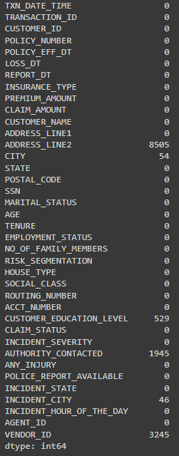
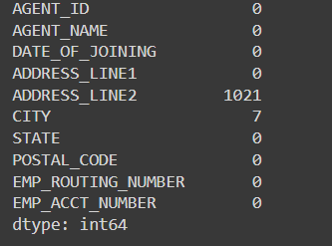
Limitations
Missing Values

Slide 5
Solution
Address Line 2 can be considered for removal, as it does not provide significant value given the presence of other address-related information.
CITY, CUSTOMER_EDUCATION_LEVEL, AUTHORITY_CONTACTED, INCIDENT_CITY, VENDOR_ID.
For these columns, fill in any missing values with the designation "Unknown“
This approach ensures that these records are clearly identified as incomplete, thereby facilitating more accurate data analysis and reporting.

Slide 6
Insights

Slide 7
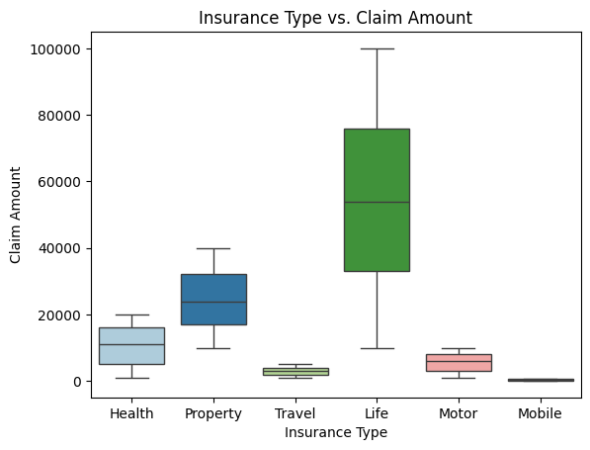
Insurance Type vs Claim Amount
Life insurance has the highest median and max claim amount also the highest variance among all insurance groups
Life insurance is riskier and more costly than other types

Slide 8
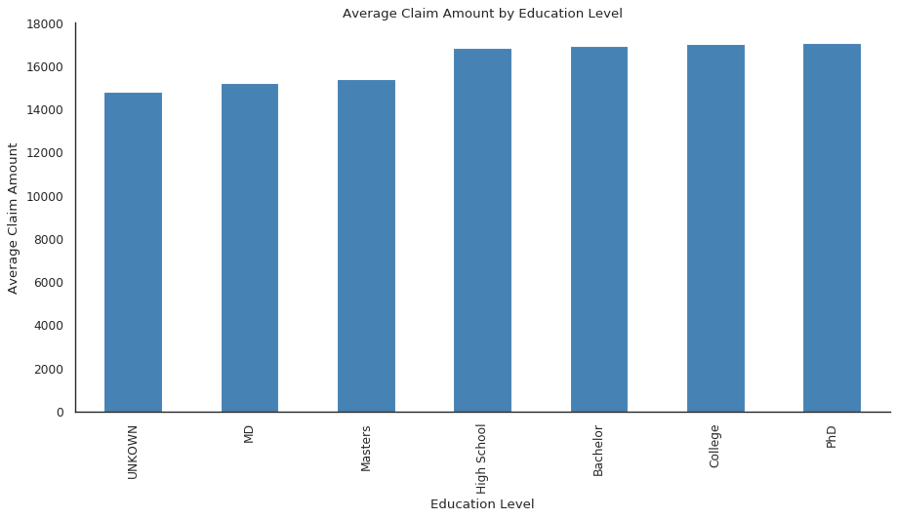
Average Claim Amount by Education Level
The average claim amount is higher generally for High School, Bachelor, College, and PhD graduates
This may indicate they file larger claim amount and are riskier

Slide 9
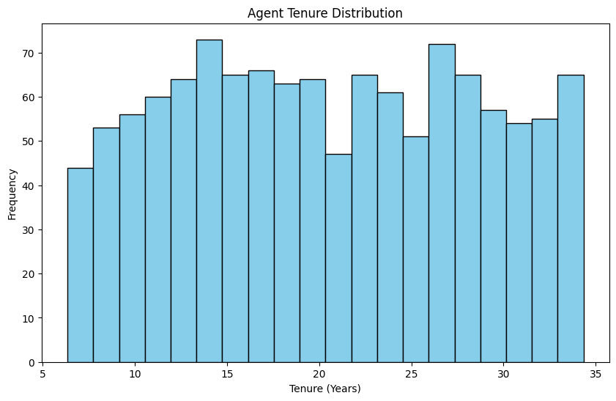
Agent Tenure Distribution
Fairly uniform with no extreme peaks and troughs
Minor peak around 15 year mark which may indicate hiring and retention success
Metlife benefit from balanced new and experienced agents
Continue with current training and workforce planning

Slide 10
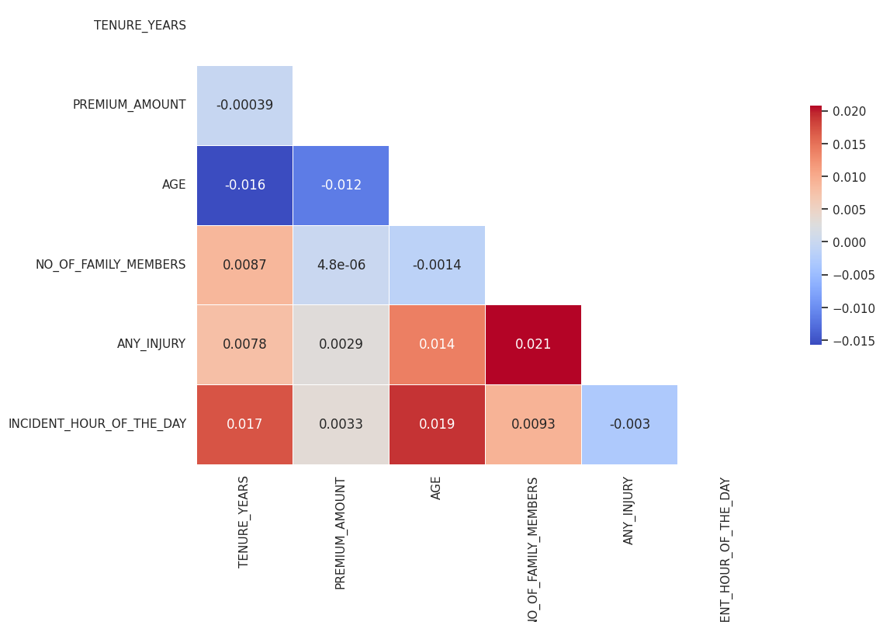
Quantitative data correlation heatmap
Visualizes correlation between numeric data among two datasets
Most demonstrate no linear correlation
Could mean there are non-linear relationships to further examine

Slide 11
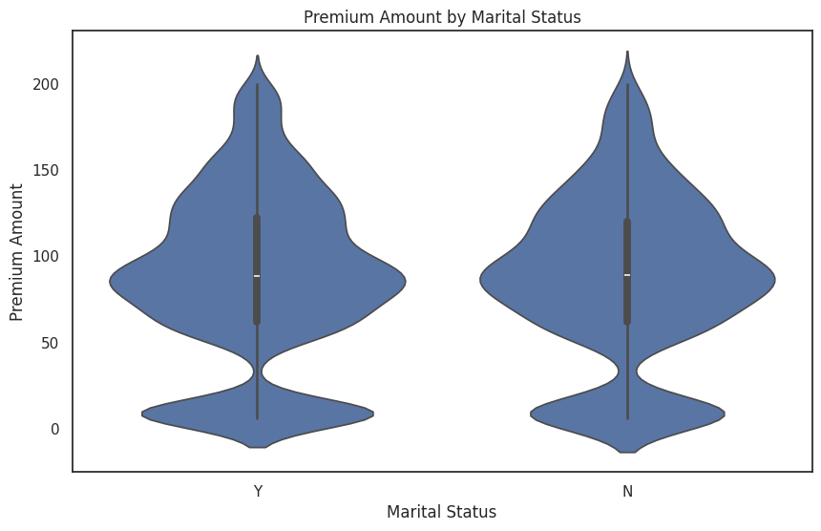
Premium Amount by Marital Status
Plot shows almost no difference in premium paid by marital status
Suggest marital status is not a risk factor
Indicate other factors are more important

Slide 12
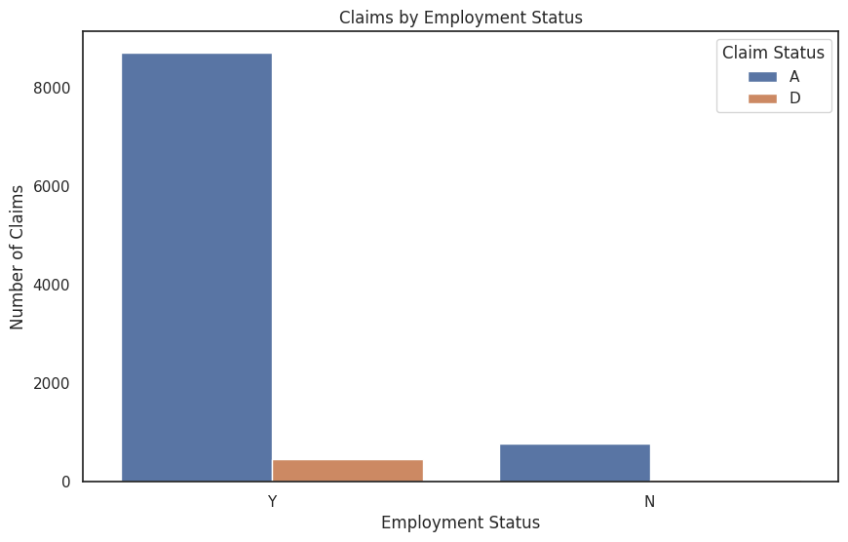
Claim Amount by Employment Status
Mismatch in claim by employment status may indicate Metlife can develop more customized insurance products towards the unemployed individuals

Slide 13
Insights Summary
Life insurance is the riskiest and costliest
Customers with high school, bachelor, college, and PhD degrees has highest average claim amount = riskier
Agent tenure is uniform(indicate good workforce planning),
No correlation between quantitative data meaning a potential non-linear relationship
Similar premium paid by marital status indicate it is a non risk factor
Mismatch in claim amount by employment status shows a need for insurance product targeting unemployed

